Slide 1
Visual Novel Engine
Developed by:
Aayush Nagpal
Harish Chowdhary Kadambala
Xiaotong Yang
CSCI 5210: Introduction to Software Engineering
Computer Science Department
University of New Orleans

Slide 2
Visual Novel
A visual novel is an interactive game, featuring mostly static graphics, sometimes using animated-style art or occasionally live-action stills (and sometimes video footage). As the name might suggest, they resemble mixed-media novels
A form of adventure game which may incorporate problem-solving and other types of gameplay
Most widely used in East countries.
Visual novels are rarely produced for video game consoles.
To build this Visual Novels, we use the Visual Novel Engine.

Slide 3
Game Play
Distinguished from other game types by their extremely minimal gameplay. Typically the majority of player interaction is limited to clicking to keep the text, graphics and sound moving
Multiple storylines and many endings; the gameplay mechanic in these cases typically consists of intermittent multiple-choice decision points, player selects a direction in which to take the game
Non-linear branching storylines
revolve almost entirely around character interactions and dialogue choices
Notes:
frequently use multiple branching storylines to achieve multiple different endings, allowing non-linear freedom of choice along the way. Decision points within a visual novel often present players with the option of altering the course of events during the game, leading to many different possible outcomes.
usually featuring complex branching dialogues and often presenting the player's possible responses word-for-word as the player character would say them. Such titles revolving around relationship-building, including visual novels as well as dating simulations

Slide 4
Style
visual novels are more likely to be narrated in the first person than the third
It is fairly common for the primary structural unit to be the day rather than the chapter
Many visual novels are centered around drama, particularly themes involving romance or family

Slide 5
Visual Novel Engine
Visual Novel Engine is a software engine which facilitates the creation of visual novels, a form of computer-mediated storytelling.
Most people tend to write ideas or scripts.
Users can use this engine to make their ideas or scripts into good looking Novels.
Engines already present in market –Nscripter, Ren,Py etc
Key component in using the engine successfully is getting familiar with Script.
Notes:
Its popularity among the visual novel community is attributed to the ease of modifying the engine to support languages other than Japanese.

Slide 6
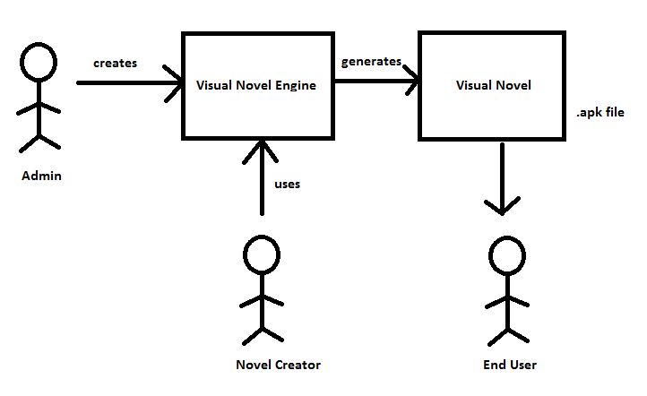
Visual Novel Overview

Slide 7
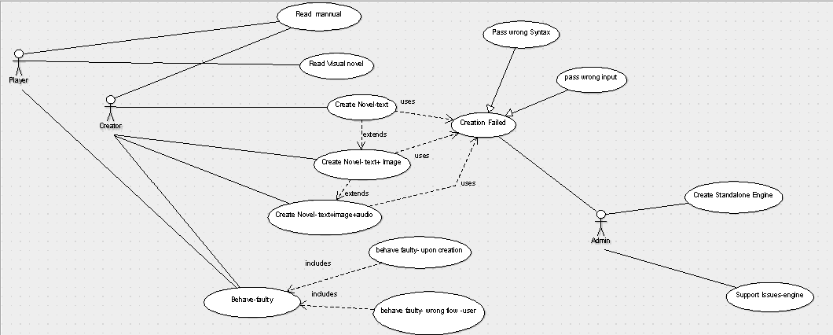
Visual Novel Overview (cont.)

Slide 8
Brain Storming
Gather requirements
Design Features
Prioritize
Divide into modules

Slide 9
Development Process
Framework
Android 6.0
Tools
Eclipse IDE with inbuilt Android SDK, Android Studio and git version control
Communication
Meetings, Slack and emails for communication
Implementation

Slide 10
Features
Android Application
Displaying text, images and playing audio files
Being Interactive with end user (Taking inputs from user)
Mute and Unmute the audio
Provide flexibility to the Visual Novel Creator
Notes:
Feature- can be played on any android device all you have to di is put high definition media in drawable folders

Slide 11

Demonstration

Slide 12
Challenges Overcame
Android
Displaying Images of different resolutions
Parallel execution of playing Audio files with image and text running
Integrating all the modules
Handling with the animations
Getting data from the end user and act upon it
Notes:
Xml file- relative layout which doesn’t take the count and location of pixel rather it calculates the area to be drawn by standard calculations considering width of the screen.
-- text was going out of the screen thus I used inbuilt textview class which solved the problem

Slide 13
Future Challenges
Preparing GUI for Visual Novel Creator to provide inputs
Add an ability to save the novel and restart from that point
Add an ability to jump into sequels of the novels
Add more animations

Slide 14
What’s Unique??
Open source
Platform Independent
Offline
Ease to use

Slide 15
THANK YOU QUESTIONS ???

